Slide 1

Chaos Coordinator
present by:
A place to organize all your to-do’s in one place. Helps miminimize the need for multiple planners.
ELIANA ONTIBON

Slide 2
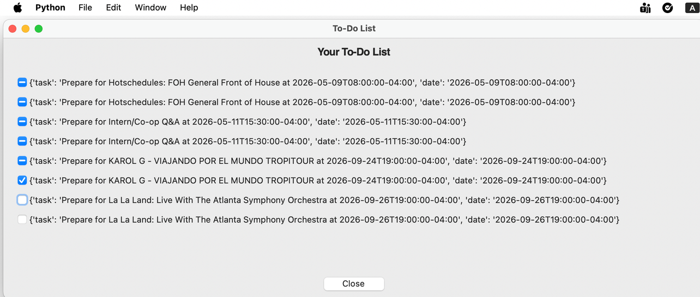
Chaos Coordinator
present by:
ELIANA ONTIBON

Slide 3
Thank you!
https://github.com/ksu-is/Chaos-Coordinator

